Slide 1
Speed and Speed Management in Nevada
Lacey Tisler, PE
5/7/2024
Notes:
Thank you for being here at the end of day one! I expect some of you have heard me talk about speed before and I appreciate you taking the time to listen to me again. Year after year, speed is a leading factor in our fatal and serious injury crashes. In fact, through March of 2024, 97 people have lost their lives on Nevada’s roadway system with the top contributing factors being impairment and speed.

Slide 2
What is a Speed Management Action Plan (SMAP)?
Characterizes speeding-related safety problems
Identifies multidisciplinary countermeasures and strategies
Outlines strategies and actions to reduce speeding and speeding-related fatalities and serious injuries
Facilitates coordination and cooperation among safety stakeholders
FHWA has documented guidance for SMAPs
“Mini SHSP” to address speeding
Notes:
A Speed Management Action Plan characterizes the speeding-related safety problems and speed management issues on the roads. A SMAP identifies countermeasures and strategies in cooperation with all traffic safety partners. Similar to the Strategic Highway Safety Plan, the SMAP will outline strategies and actions to reduce speeding and speeding-related fatalities and serious injuries. It also aims to facilitate coordination and cooperation among safety professionals in the implementation of the plan.

Slide 3

“Speed is at the heart of a forgiving road transportation system. It transcends all aspects of safety: without speed there can be no movement, but with speed comes kinetic energy and with kinetic energy and human error come crashes, injuries, and even deaths.”
$$KE=\frac{1}{2}mv^{2}$$
-Organization for Economic Co-operation and Development
Notes:
The system needs speed to operate. We need to balance that operation need with the understanding that humans make mistakes and speed combined with mistakes can lead to injury and death.

Slide 4
Speeding-Related Safety Problem
Notes:
The first step was to dig into the data and understand the speed and speeding related safety problem. We quickly realized that we would need to focus on the speeding from crash data. Here is a summary of what we found.

Slide 5
Speeding-Related Fatal Crashes
Notes:
The team made the decision to use pre-pandemic data understanding that speed compliance decreased during the pandemic.
Data from 2015-2019 indicates that there were 454 speeding-related fatal crashes, representing 31% of all fatal crashes within Nevada. Nearly 60% of the speeding-related fatal crashes involved impaired driving, and almost half involved lane departures.
Our data team continues to track speeding related crashes. Year after year we find speed to be a significant factor.

Slide 6
Estimated Cost of Speeding-Related Crashes to Society
Notes:
Over the five-year study period (2015- 2019), speeding-related crashes resulted in a $4.4 billion economic impact for the state of Nevada in comprehensive costs to society in addition to the personal loss of life and health. The personal loss of life and health equates to nearly $1 billion per year in economic impact for speeding-related crashes in Nevada.

Slide 7



Speed and Impact on Pedestrians
If hit by a vehicle traveling at
Pedestrian survives
Pedestrian fatality
20 mph
10% chance of fatality
30 mph
40% chance of fatality
40 mph
80% chance of fatality
Vehicle Speed comparison to chance of Pedestrian Injury and Fatality, Data source: US Department of Transportation, Literature Reviewed on Vehicle Travel Speeds and Pedestrian Injuries. March 2000.
Notes:
38% of the lives lost through March 2024 have been pedestrian (totaling 37 lives). Data from this year shows that the bulk of the pedestrian fatalities are happening on both urban and rural facilities posted at 45 MPH.

Slide 8
Speeding-Related Crashes are More Severe on Lower Speed Roadways
Notes:
On roads with speed limits greater than 60 mph, speeding-related crashes are more common and result in over half of all speeding-related crashes. However, roads with speed limits greater than 60 mph represent less than one-third of fatal and serious injury crashes. Approximately one-third of speeding-related crashes occur on roads with speed limits between 30 and 49 mph, but almost half of speeding-related fatal and serious injury crashes occur on roads with these speed limits.

Slide 9
Speeding-Related Crashes are More Severe on Functional Class 3 and 4 Roadways
Notes:
Approximately one-third of all crashes occur on Functional Class 3 and 4 roadways, yet almost half of fatal and serious injury speeding-related crashes occur on Functional Class 3 and 4 roadways.

Slide 10
Speeding-Related Crashes are Over-Represented in Rural Counties
Source: 2015-2019 NCATS
Notes:
Six percent of Nevada’s population lives in rural counties. Fifteen percent of all speeding-related crashes occur in rural counties, and nearly one-third of fatal and serious injury crashes occur in rural counties. Speeding-related crashes are over-represented in rural counties in Nevada based on the crash data compared to population.

Slide 11
Speeding-Related Crashes are Intersection-Related
Notes:
Throughout Nevada, nearly half of all speeding-related crashes occur at intersections. However, for Functional Class 3 and 4 roadways (where almost half of the speeding-related fatal crashes and serious injuries occur), the percentage of speeding-related crashes at intersections is much higher, 62% and 71% respectively.

Slide 12
Speed Impacts on Other Crash Types
Source: 2015-2019 NCATS
Notes:
More than half of all bicycle and pedestrian fatal and serious injury crashes are speeding-related, nearly one-third of all motorcycle fatal and serious injury crashes are speeding-related, and one-quarter of unrestrained fatal and serious injury crashes are speed-related.

Slide 13
Strategies, Actions and Countermeasures
Notes:
A multidiciplinary Technical Advisory Committee was brough together to review the data and propose multidisciplinary strategies, actions and countermeasures. The group consisted of SHSP stakeholders and traffic safety partners. Many of these actions are in process. Please let me know if you are interested in supporting or moving them.

Slide 14

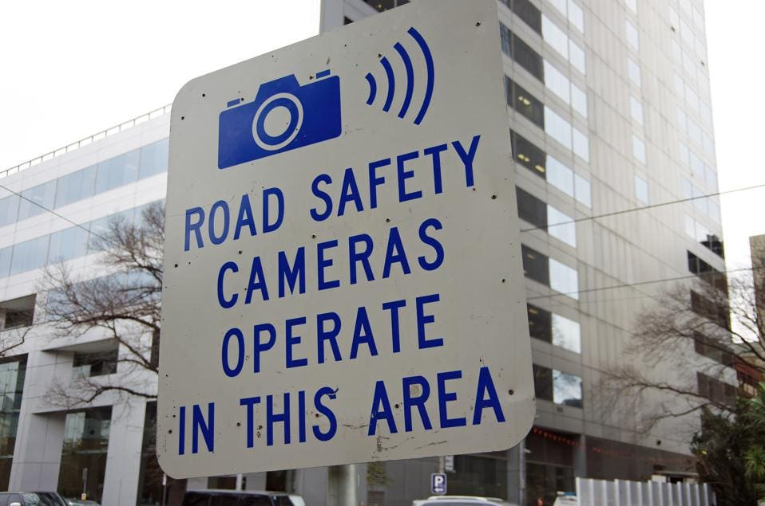

Communications and Education
Strategy
  Frame the speeding and speed-related safety problem and build support for effective policies and comprehensive actions to seek and leverage funding and improve effectiveness of enforcement and engineering countermeasures
Actions
  Seek support for technologies to improve enforcement reach and effectiveness (e.g., automated enforcement or safety cameras)
  Improve communications regarding the safety reasons for speed management efforts to increase support for effective policies and strategies
Notes:
We start with communications and education. John Pensuelas mentioned this when he talked about Road Diets earlier. There are times when the community does not understand why we talk about speeding as there is a cultural belief that it is a minor infraction.
When we talk about speeding we often think of the high profile crashes that gain media attention. Examples are Henry Ruggs III striking Tina Tintor at over 120 MPH on Rainbow and Gary Dean Robinson driving entering the intersection of North Commerce Street and Cheyenne Avenue at 103 MPH striking a minivan and ending 9 lives. These events are tragic but they overshadow the systemic speeding issues we see on our roadway system.
Many of the lives lost on our roadway system are associated with more ‘everyday’ speeding events. Most of the data I just shared comes from people rushing about their personal or professiona business. People moving quickly to get from point A to B. These people going with the flow of traffic, driving the road in a way that feels right, believe that they will not get a ticket or ever have a problem with this everyday speeding behavior. The data shows the risk. If you take nothing else with you from this presentation, please remember that the risk is real.

Slide 15
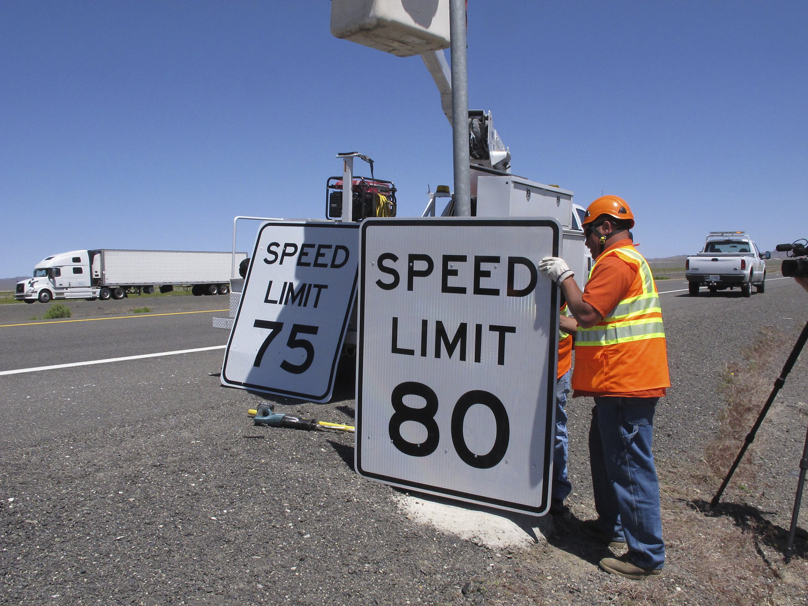

Setting Speed Limits
Strategy
  Develop a task force to engage on target speed and speed limit setting and safety (SHSP Safe Speed Task Force)
Actions
  Develop guidance and procedures for setting more uniform speed limits for different land uses and road types
  Develop a collaborative speed limit-setting process among State and local stakeholders
  Conduct outreach/training to decision-makers and/or practitioners
  Provide outreach on impacts of speeds and speed limits on safety
Notes:
The Strategic Highway Safety Plan has a task force for this strategy and the Advisory Committee on Traffic Safety supports actions for all road owners regarding target speed. Many agencies are looking beyond the functional class when setting speed limits. The historic nature of a road is important, but it is important to look at context, land use and peoples movement patterns when making these decision.

Slide 16
Plan/Design for Speed Management
Strategy
  Develop an inter-agency speed and safety assessment process to review plans, designs, and implementation to ensure that new projects meet sound speed management design and operations principles for the area land uses and intended purposes of the road
Actions
  Develop guidance and procedures for setting more uniform speed limits for different land uses and road types
  Develop a collaborative speed limit-setting process among State and local stakeholders
  Conduct outreach/training to decision-makers and/or practitioners
  Provide outreach on impacts of speeds and speed limits on safety
Notes:
Guidance has been issued by the department regarding Speed Management. It aligns with much of the speed and safety work issued by the FHWA. I will touch on it at the end of this presentation and I am looking for partners to help move these actions steps along.

Slide 17
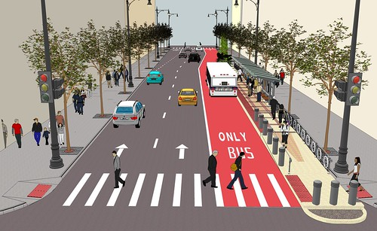
Systemic Actions and Strategies in High Crash Corridors
Strategy
  Develop and implement a systematic speed and safety treatment prioritization process
Actions
  Conduct network screening to prioritize roads (corridors, roadway segments, intersections) with potential speeding-related safety issues
  Take advantage of maintenance and operations opportunities to implement design or engineering improvements to reduce speed, and consider countermeasures identified in the Strategies to Achieve Desired Operating Speed Matrix
  Apply consistent/similar countermeasures to similar location/problem types as identified in the Strategies to Achieve Desired Operating Speed Matrix
  If speeding is an issue along a corridor, implement the appropriate countermeasures for the roadway environment located within the Strategies to Achieve Desired Operating Speed Matrix
Notes:
Use existing data sources to understand the risk in corridors and include countermeasures in the environment to reduce the speeding related risks.

Slide 18
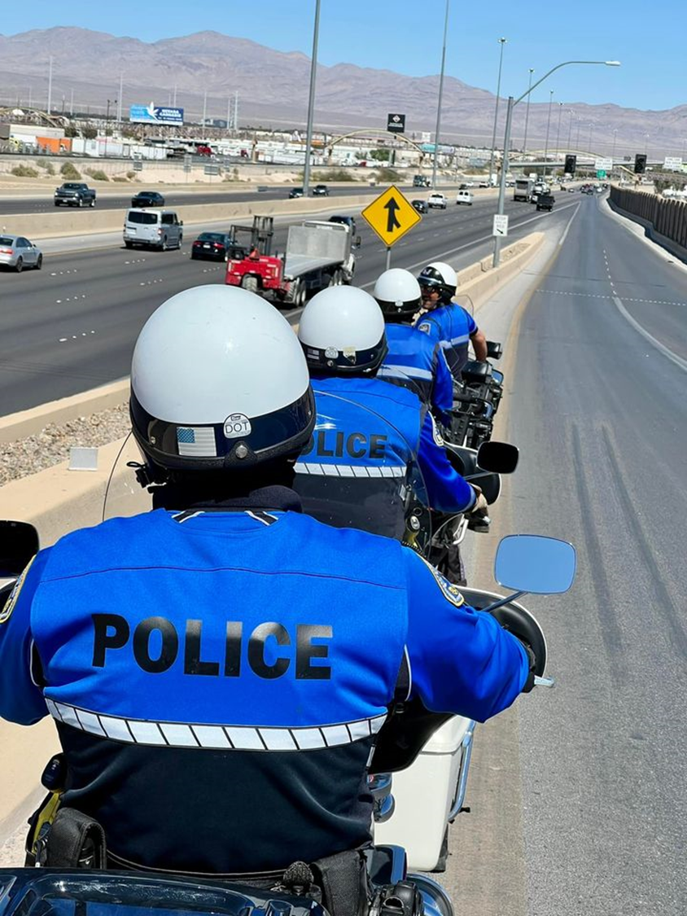
Enforcement and Publicity on High Crash Corridors
Strategy
  Develop and implement a sustainable, high-visibility enforcement (HVE)and adjudication program targeting areas of the network where serious crashes occur
Actions
  Support HVE efforts for aggressive driving and speed with strong multiple-channel messaging and outreach to encourage appropriate speeds
  Implement automated enforcement with civil penalties in areas where supplemental or continuous enforcement is needed (starting with school and work zones)
Notes:
Partner with enforcement partners and publicize speeding messages on high risk corridors. This may not be a long term solution, but it works in the moment and can curb behavior.

Slide 19
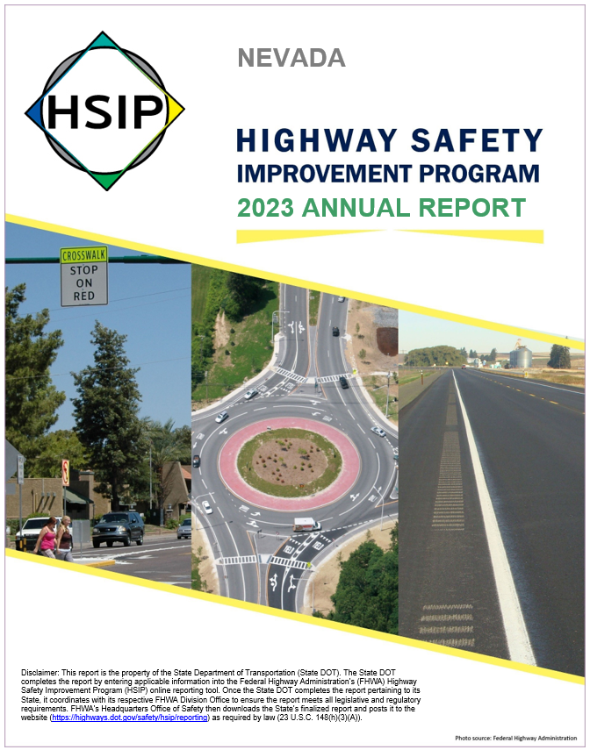
Systemic Speed Review within the Highway Safety Improvement Program (HSIP) and Other Safety Programs
Strategy
  Implement speed and safety reviews within the HSIP program, and coordinate with other transportation safety plans
Actions
  Implement corridor or area-wide speed reviews and speed management countermeasures if needed to supplement spot safety improvements
  Coordinate with law enforcement to supplement or provide enhanced enforcement before engineering measures can be implemented
Notes:
Continue to review the program using the best available data and incorporate best practices from our peers and partners.

Slide 20

Speed and Speeding-Related Data
Strategy
  Identify opportunities to improve speed and speeding-related data
Actions
  Identify how Fatality Analysis Reporting System (FARS) data can be incorporated into the Nevada Citation and Accident Tracking System (NCATS) dataset to close the gap in reporting speeding-related fatal crashes
  Determine methods to track and monitor speed along corridors
Notes:
Develop tools to collect and use better data. We have established that speeding in certain corridors is a high risk for fatal and serious injury crashes. I am looking forward to the day where we can identify projects based off of speeding risk rather than react to lives lost on the roadway system.

Slide 21
Engineering Countermeasures to Set Target Speeds
Notes:
Early in this conversation, I mentioned that impairment and speed are the top contributing factors year after year. I often hear that there is nothing that a road owner or designer can do about the speeding issue.
I’d like to challenge that assumption and share a number of design elements that can impact speed.

Slide 22
Speed Management Countermeasures Along Roadways
Speed safety cameras (speed safety cameras are currently not legal in Nevada)
Lane narrowing
Technology-driven solutions – could include speed feedback signs, speed monitoring cameras, Strategic Traffic Monitoring Sites (STMS), etc.
In-pavement speed limit markings
Transverse lane markings
Gateway treatment
Addition of median or two-way left-turn lane (TWLTL)
Horizontal deflection
Medians and pedestrian refuge islands
Roadway reconfiguration (four- to three-lane conversion)
Landscaping
Terminated vista
On-street parking
Vertical deflection
Notes:
Here is a list of countermeasures along roadways. Research is continuing and new countermeasures are being studied. I expect this list to grow in the future.
Many of these countermeasures add visual friction to the roadway system encouraging drivers to actively engage. That active engagement often leads to slowing down. I have a few that I would like to share.

Slide 23
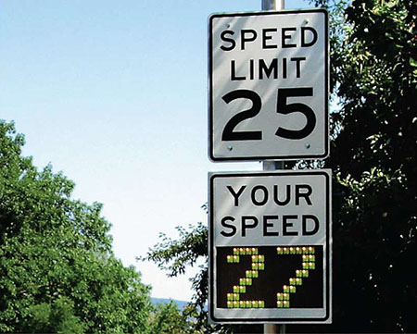
Speed Feedback Signs
These portable, interactive signs display a vehicle’s current speed to remind the driver to slow down and obey the posted speed limit. Research shows these types of signs have been effective at reducing speeds by 5 mph.
FHWA, “A Desktop Reference of Potential Effectiveness in Reducing Speed,” July 2014:
http://safety.fhwa.dot.gov/speedmgt/ ref_mats/eng_count/2014/reducing_speed.cfm
Notes:
Speed feedback signs serve as a simple reminder and many drivers respond to the external feeback about here speed. There are some concerns that the lose effectiveness over time, but there is research that shows a speed reduction of 5 MPH.

Slide 24
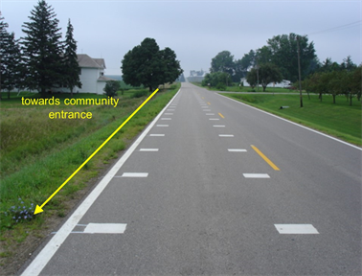
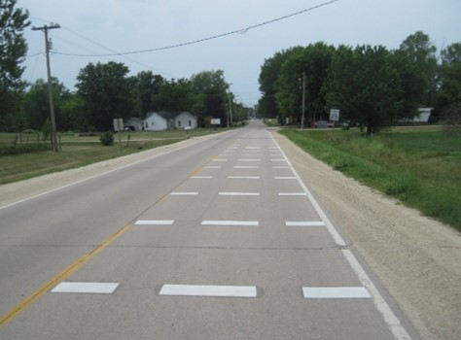
Transverse Pavement Markings
Per MUTCD 11th edition they are called Speed Management Markings
These markings increase drivers’ perception of speed causing them to reduce speed
Often called Optical Speed Bars because they work like an optical illusion, nudging drivers to ease off the gas pedal
Notes:
Transvers Pavement Markings or Speed Management Markings increase drivers perception of speed causing them to slow down naturally.
The department is planning to deploy these markings at the entrance of rural towns. We may be looking at other applications.

Slide 25
Speed Management Countermeasures At Intersections
Increase Visibility
Roundabout
Small modern roundabouts and mini roundabouts (not traffic circles)
Bulb-outs/neck downs
Textured surfaces
Diagonal diverter
Raised intersection/vertical deflection
Neighborhood traffic circle (not roundabouts)
Transverse rumble strips
Notes:
Here we have a list of countermeasures that can be deployed at intersections.

Slide 26
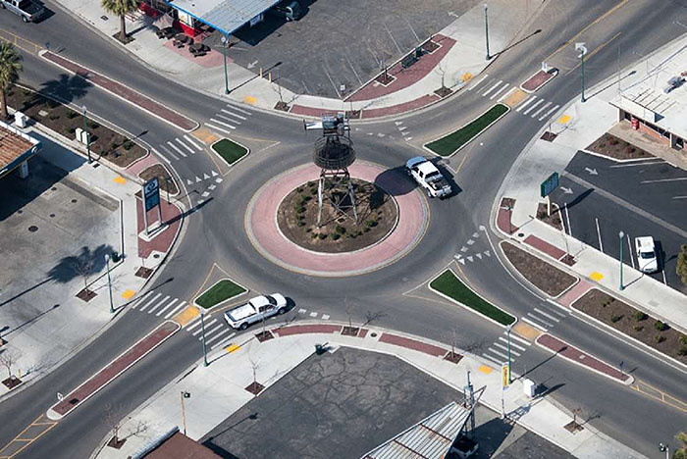
Roundabouts
This type of circular intersection is very effective at safely moving traffic through an intersection and can have significant traffic calming effects. Features such as channelized approaches, a center island, and circular design encourage lower speeds. Studies have shown roundabouts can lower speeds by as much as 15 to 20 mph and reduce severe crashes by nearly 80 percent.
FHWA, “A Desktop Reference of Potential Effectiveness in Reducing Speed,” July 2014:
http://safety.fhwa.dot.gov/speedmgt/ ref_mats/eng_count/2014/reducing_speed.cfm
Notes:
The safety performance of a roundabout is a product of its design. At roundabouts, vehicles travel in the same direction, eliminating the right-angle and leftturn conflicts associated with traditional intersections. In addition, good roundabout design places a high priority on speed control. Speed control is provided by geometric features, not just by traffic control devices or by the impedance of other traffic. Because of this, speed control can be achieved at all times of day. If achieved by good design, in principle, lower vehicle speeds should provide the following safety benefits: • Provide more time for entering drivers to judge, adjust speed for, and enter a gap in circulating traffic, allowing for safer merges; • Reduce the size of sight triangles needed for users to see one another; • Increase the likelihood of drivers yielding to pedestrians (compared to an uncontrolled crossing); • Provide more time for all users to detect and correct for their mistakes or mistakes of others; • Make crashes less frequent and less severe, including crashes involving pedestrians and bicyclists; and • Make the intersection safer for novice users.

Slide 27
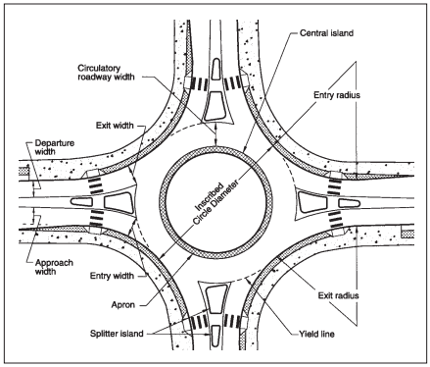
Roundabouts continued
Designed for a maximum entry speed of 25 mph for single-lane and 30 mph for multilane roundabouts
Small inscribed circle diameters
Narrow entry widths
Raised central islands
Curve deflection on entry and exit
Splitter islands
Notes:
A roundabout provides horizontal deflection with an island at the entry point. They require every vehicle to follow a circuitous path no matter which departmerure leg of th eintersection is at the destination. This results in moderated speeds through the intersection.

Slide 28
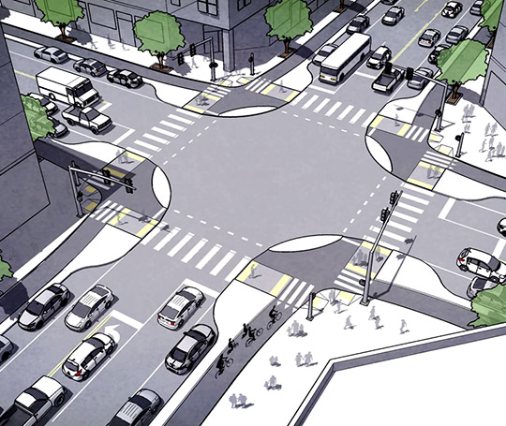
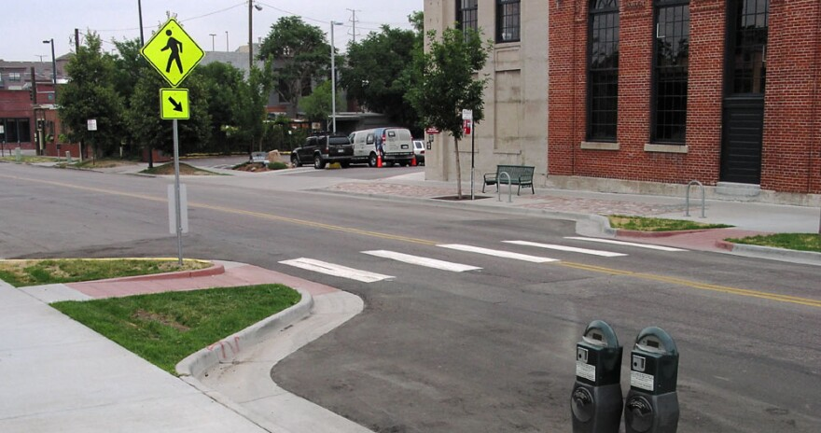
Bulb Outs/Neck Downs
Extending the sidewalk for a bulb out is a cross cutting
It narrows the lane causing visual friction for the drivers
It increases visibility and encourages drivers to pay special attention to their surroundings
It helps pedestrian safety by shortening the crossing distance
Notes:
Bulb outs and neck downs draw attention to the intersection and provide visual clues to the driver that there could be other users in the area. It feels like there could be conflicts and drivers naturally respond by slowing down.

Slide 29
Selecting Countermeasures to Achieve Target Speed
Practitioners should consider a variety of factors when selecting countermeasures including the following:
  The roadway environment
  Desired operating speed
  Existing operating speed
  Existing and future community needs
  Existing and future multimodal needs
  Safety of roadway users
  Emergency response vehicles

Slide 30
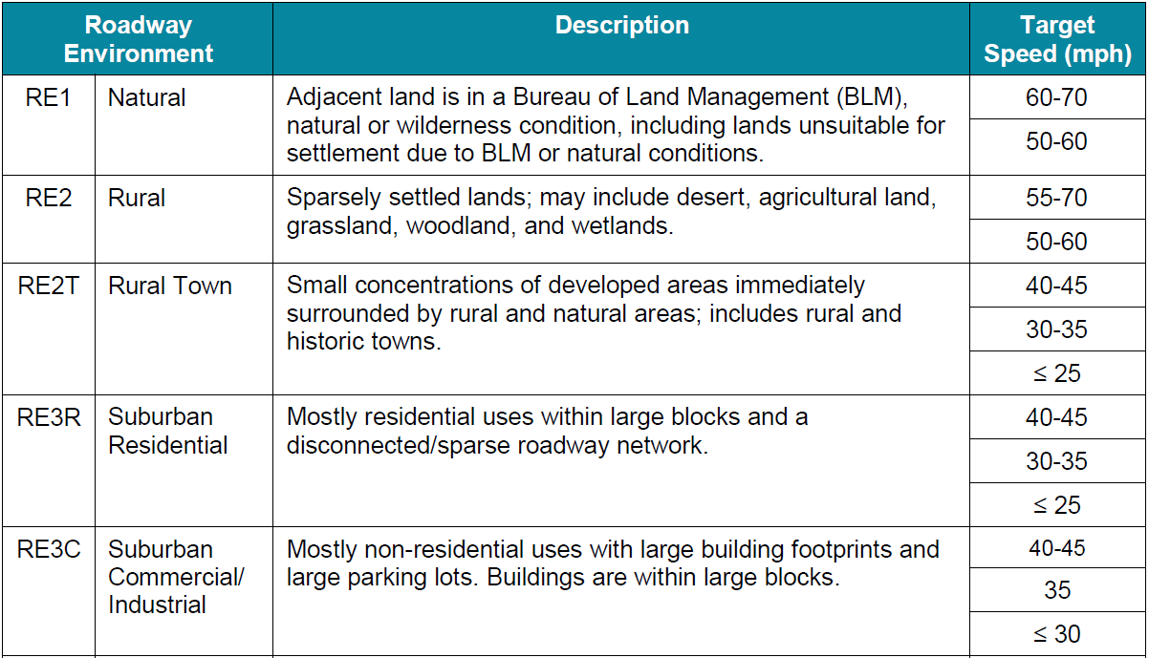
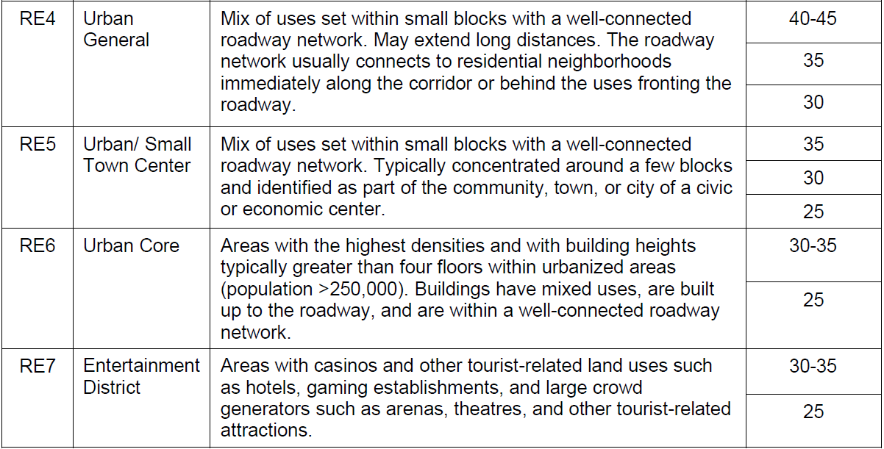
Determine Roadway Environment
Notes:
Projects should be uniquely planned and designed to be in harmony with the surrounding
land use characteristics and the intended uses of the roadway. To this end, a roadway
environment system comprising nine roadway environment classifications has been
developed.
The roadway environment classifications and associated target speed determine key design
criteria elements for arterials and collectors. This does not apply to Interstates or other gradeseparated
facilities, where the primary function of these facilities is to move vehicles quickly.
It is important to note that the roadway environment is different than functional classification
of a roadway. The roadway environment was developed to take into account the surrounding
land uses in order to develop a target speed.
As an example, let’s talk about Sahara to the north.

Slide 31
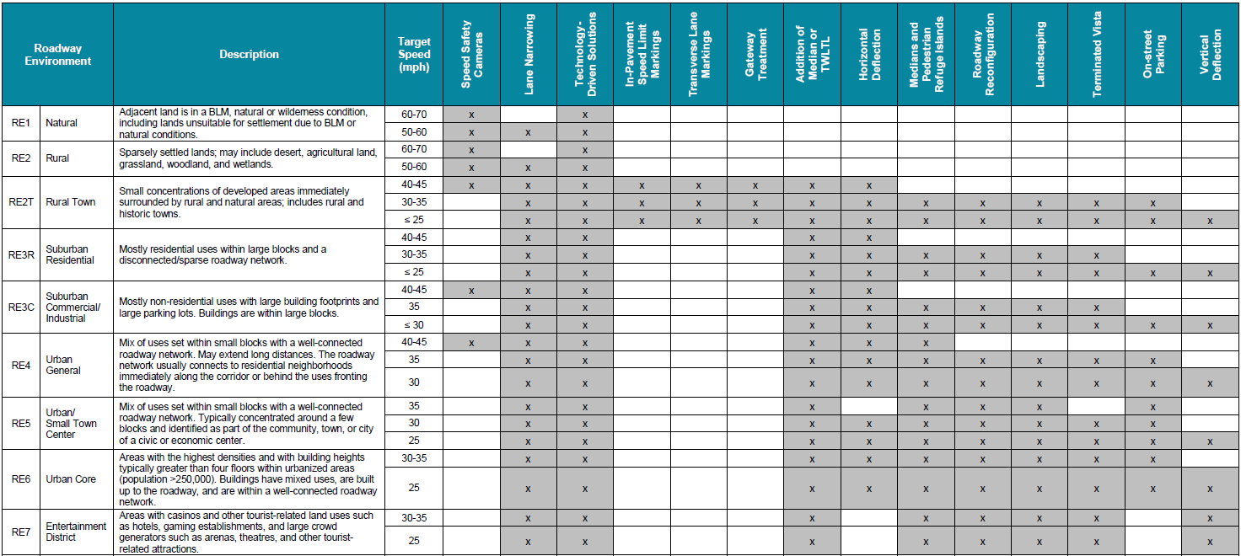
Countermeasures to Achieve Target Speed Along Roadways

Slide 32
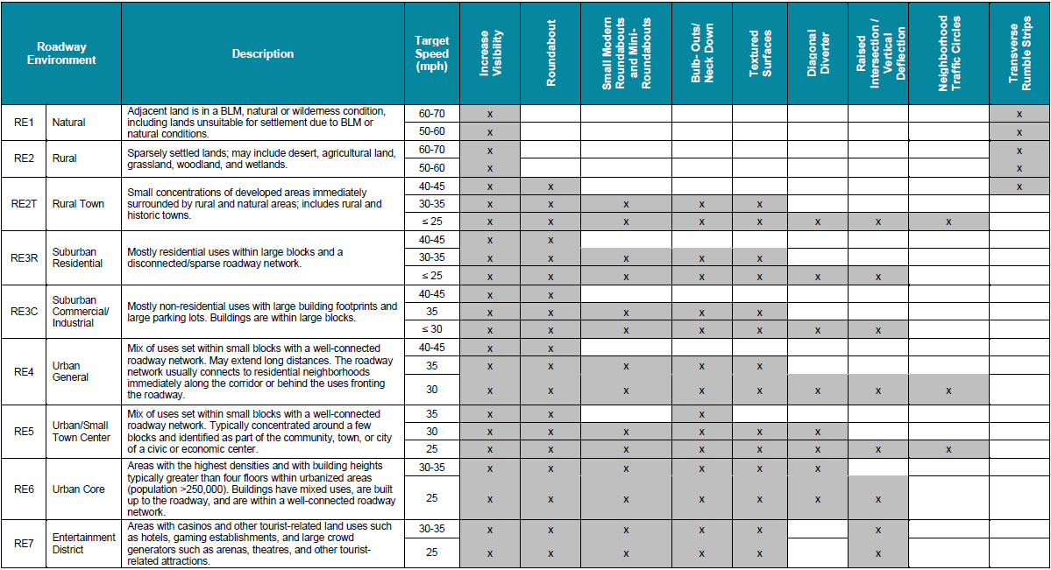
Countermeasures to Achieve Target Speed at Intersections
Notes:
Last slide – If time I want to take a moment to chat a bit more about speed and everyone.

Slide 33
Questions?

